Slide 1
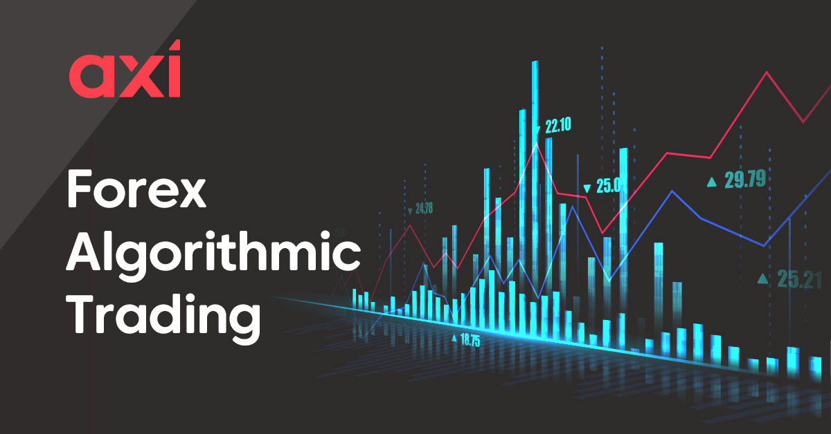
Algo Trading
© Templateswise.com
Team Adelaide
Fiona Bai - 21jb69@queensu.ca​​
Ishaan Sinha - 20is38@queensu.ca​
Kripa Nayak - 21ksn1@queensu.ca​​
Marshal Yuan - 21yy40@queensu.ca ​
Oluwaseun Adelana - 21oa9@queensu.ca​​
Rachel Chen - 21jc69@queensu.ca​
Presented by : Team Adelaide

Slide 2
Content
Executive Summary
Introduction – Algo Trading
Benefits of Algo Trading
Trading Strategy – Mean Reversion
Pairs Trading
Data Source
Model Walkthrough
Output
Next Steps

Slide 3
Executive Summary
Team Adelaide is poised to make organizations richer by increasing their investment returns
Rags to Riches Capital has employed our services to assist their treasury team identify options which beats the market returns
We’ve identified key options which can be implemented within Rags to Riches Capital current portfolio to maximize returns
We did a feasibility study to evaluate each trading strategy and found Algo trading to be the best fit our client’s needs

Slide 4
Executive Summary
Legal
Technology Ready
01
02
Legal, utilized by firms all over the globe
Easily Deployable
Increases Returns
03
Scheduling
04
Can be deployed within a months time
Effective trading strategies can help maximize portfolio profits
#Make Money BOT

Slide 5
Introduction
Algorithmic trading combines computer programming and financial markets to execute trades at precise moments
Common trading strategies include trend-following strategies, arbitrage opportunities, and index fund rebalancing
Algorithmic trading is also executed based on trading volume or the passage of time

Slide 6

Benefits of Algo Trading
01
02
Remove Emotion
Increase Activity
Benefits
03
04
Quick Execution
Backtest Strategies

Slide 7
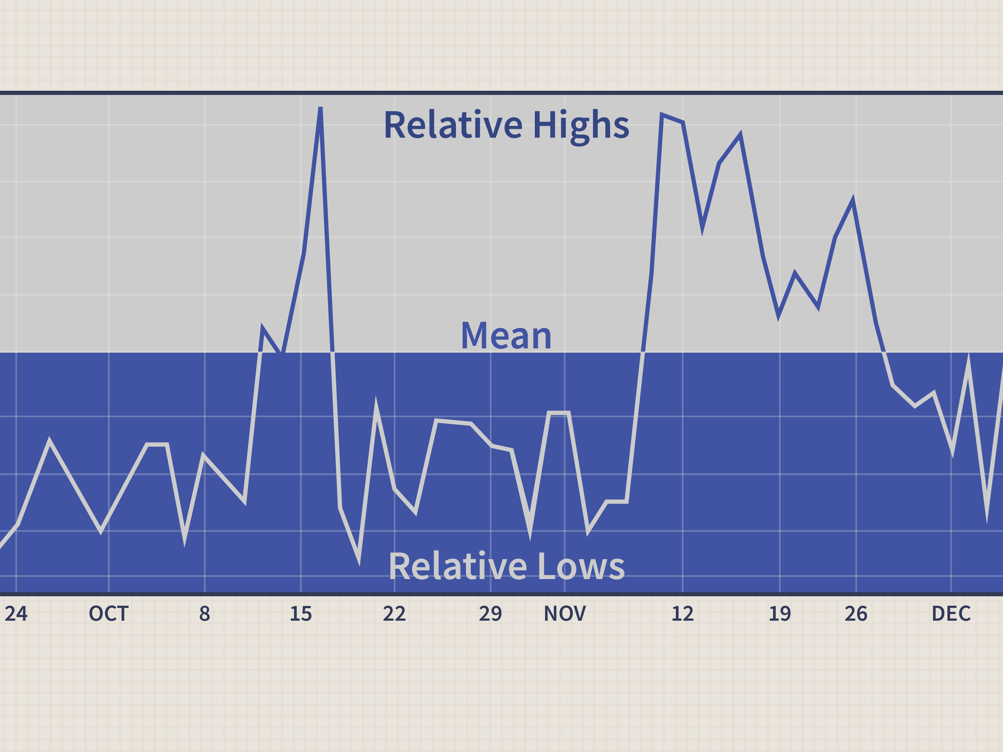
Trading Strategy : Mean Reversion
Usage
Used as a statistical analysis of market conditions
Strategy
Asset prices and historical returns gradually move towards the long-term mean
Fundamentals
Greater the deviation from mean, higher the probability that the next movement will be closer to the mean
Assumption
Profitable trade when there’s a significant deviation from the historical correlation between two shares
Notes:
https://corporatefinanceinstitute.com/resources/knowledge/trading-investing/mean-reversion/
A pairs-trading strategy, whether it’s based on the relationship between two similar companies, or even between two shares classes of the same stock, assumes that you can profitably trade when there’s a significant deviation from the historical correlation.
https://www.warriortrading.com/mean-reversion/

Slide 8

Mean Reversion : Pairs Trading
Subset of statistical arbitrage
Takes advantage of the mispricing between two co-moving assets
01
02
03
04
Strategy involves betting that relationships will hold and prices will converge
Opportunities of machine learning
Fundamental principle: “buy undervalued – and sell overvalued”
Notes:
https://hudsonthames.org/definitive-guide-to-pairs-trading/

Slide 9

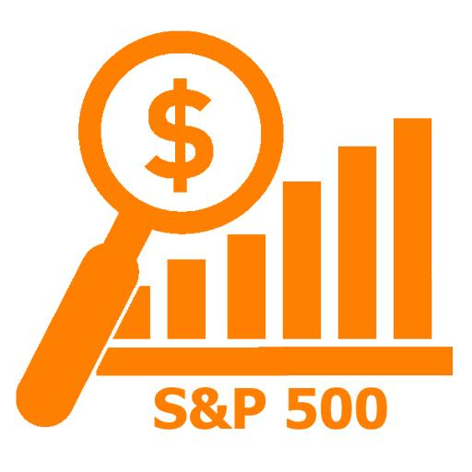
Model : Data Source
We’ve utilized publicly available stock data from Yahoo Finance
Our main focus was to target stocks listed on S&P500 to avoid conflicts with ticker naming convention across indices
Two years historical data for the technology sector has been utilized to develop and implement our trading strategy

Slide 10
Algorithm Trading Process
01
02
03
Find Stock Pairs
Analyze Historical Stock Performance
Feature Engineering
04
05
Implement Buy&Sell Strategy
Model Tuning &
Back testing

Slide 11







Strategy – Pairs Trading
Information Technology
Correlation
Stationarity
Cointegration
S&P 500

Slide 12
Strategy – Pairs Trading
Information Technology
Correlation
0.97664
Cointegration
0.000808
P-value
P-value of spread
*Stationarity
0.00328
0.000165
P-value of price ratio
* Based on Augmented Dickey Fuller test
Notes:
Augmented Dickey Fuller test (ADF Test) is a common statistical test used to test whether a given Time series is stationary or not. It is one of the most commonly used statistical test when it comes to analyzing the stationary of a series.

Slide 13
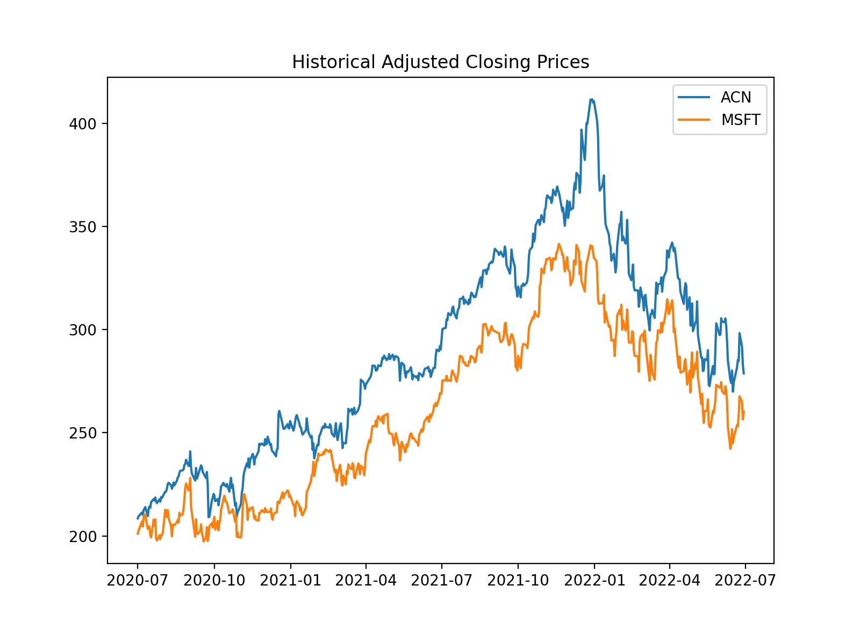
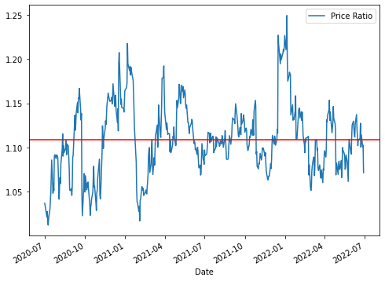
ACN & MSFT: Stock Price over 2 Years
Price Ratio = ACN/MSFT
June 25 2022
ACN: $298.31
MSFT: $267.70
Price Ratio: 1.114

Slide 14
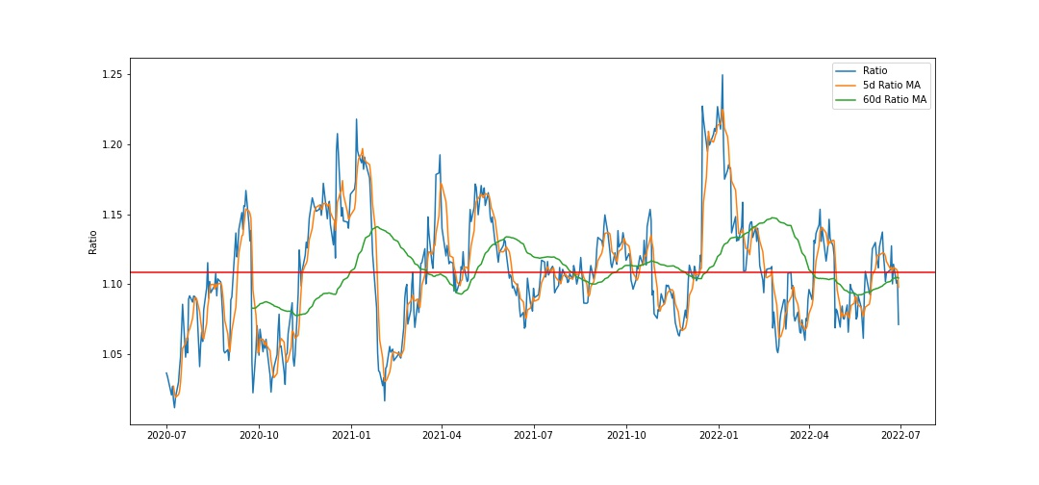
Feature Engineering
z score: (5d MA — 60d MA) /60d SD

Slide 15
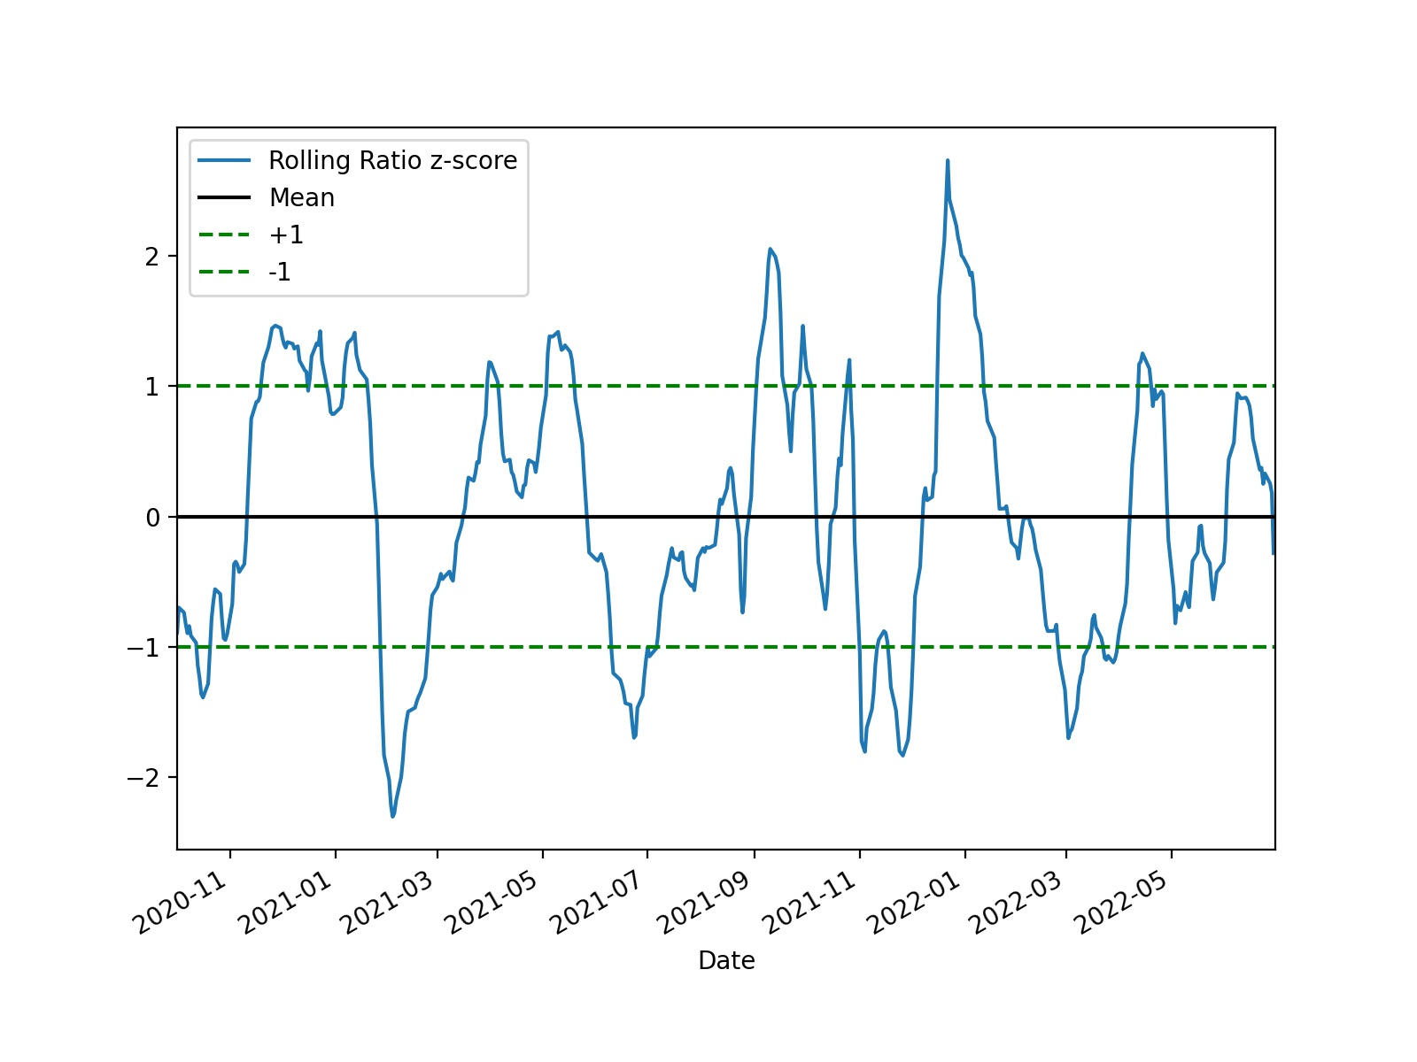
Trading Strategy
Presumption: ACN is overvalued, MSFT is undervalued
Trading Strategy: Short ACN ;Long MSFT
Exit Position:
|Z-score| < 0.5
Stop Loss at 8%
Presumption: MSFT is overvalued, ACN is undervalued
Trading Strategy: Short MSFT ;Long ACN
Notes:
When z score is close to 0, exit the position

Slide 16
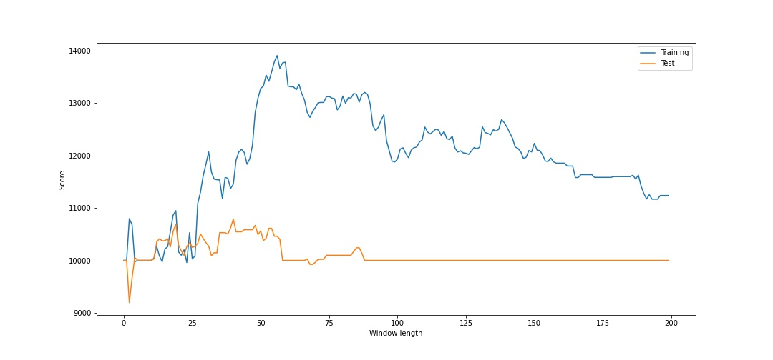
Optimizing the Strategy
Portfolio value vs window length for training and test data
56d Moving Average
Notes:
Model tuning:
In order to improve the model and avoid overfitting, we carried out some parameter tuning.
Initially, we estimated the window length by trying out a 5d (rolling mean) and 60d (rolling standard deviation) moving average. However, we decided to vary the window length using parameter tuning to find an optimized window length between 0-200.
What you see on this graph is a plot of the portfolio value against window length for which the moving average is calculated for the training data set (represented by the blue line) and test data set (represented by the orange line). As the model iterates over all the possible window lengths, it peaks at the 56d MA which would give the highest return for our training and data set.

Slide 17
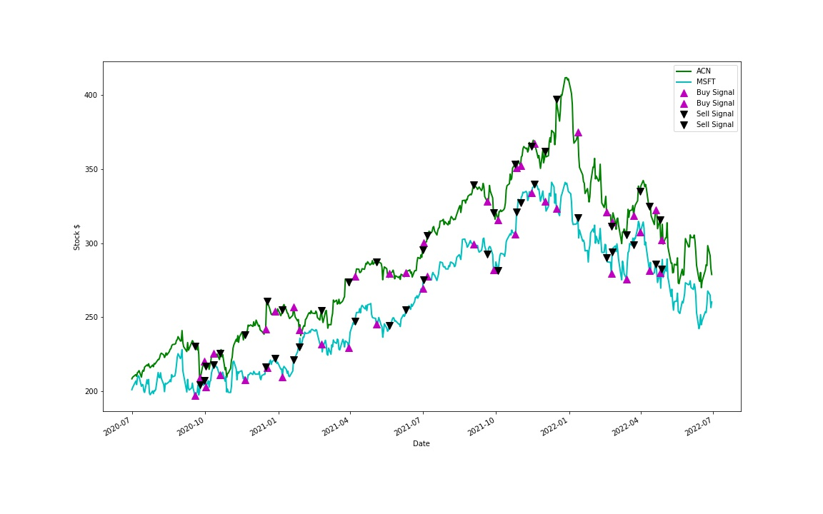
Buy/Sell Signals for Accenture & Microsoft
Notes:
Here, you see the details of the implementation of our buy low and sell high strategy – this a graph of the stock price of ACN & MSFT shares over the trading period of 2years.
The green trend line represents ACN while the blue represents MSFT, the purple marker signifies buy signal while the black signals selling.
Highlight: With the pair trading approach, we are immune from the overall market movement and always have a hedged position because when we take a short position, we earn money if the asset sold loses value, and if we take a long position, we make money if the asset gains value. In this case, we buy MSFT when it is undervalued and sell ACN when it is overvalued and vice versa.
Let’s see a sample of how these trades were executed.

Slide 18
Output: Backtesting the Trading Strategy
 | Accenture (ACN) |  |  | Microsoft (MSFT)
Date | Price | Position | Holding | Price | Position | Holding | Cash | Portfolio Value
2020-07-01 | $208.46 | - | $0.00 | $201.09 | - | $0.00 | $10,00.00 | $10,000.00
 | … |  | … | …
2020-09-18 | $230.27 | Short | ($5,526.67) | $197.33 | Long | $5,722.76 | $9,803.91 | $ 10,000.00
2020-09-21 | $228.06 | Hold | ($5,473.55) | $199.45 | Hold | $5,784.16 | $9,803.91 | $ 10,114.51
2020-09-22 | $230.99 | Hold | ($5,543.99) | $204.25 | Hold | $5,923.52 | $9,803.91 | $ 10,183.44
 | … |  | … | …
Notes:
We started our trade with 10K split between two stocks (ACN and MSFT) and then backtested our strategy by trading 24 shares of ACN and 29 shares of MSFT at each buy/sell signal.
Here’s a random sample of how the trades were implemented.
On our first day, we have taken no position and hence had 0 holding value for ACN & MSFT.
However, on the 18th of Sept 2020, we take a short position for ACN with a –ve value of 5,526.67 while simultaneously taking a long position for MSFT at a value of 5,722.76. This gives us a cash position of 9,803.91 and a portfolio value of 10,000. However, on the 21st and 22^{nd,} we continue to hold our position, notice that our cash value remains the same, but the portfolio value increases on both days due to changes in the stock prices.
Let’s see what profits were generated over the 2year period.

Slide 19
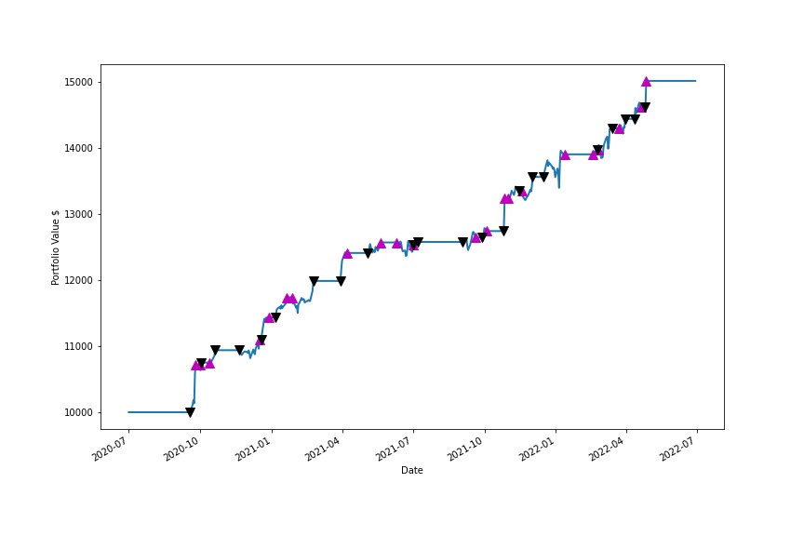
Portfolio value over the trading period
$15,014.49
Notes:
So, we can safely conclude that our strategy is profitable because we were able to increase our portfolio from 10k which we started to trade with in July 2020 to about 15k in July 2022 – that is a 50% increase in our portfolio value over a period of 2years.

Slide 20
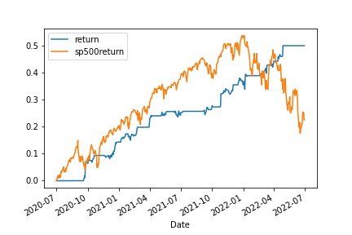
Our Return vs S&P 500 Index
Notes:
if we compare our return with that of the S&P 500 index; notice how relatively close they both perform until the huge variation between Apr 2021 and Jan 2022.
However, the S&P 500 suffers a decline and makes a total return of about 25% while ours consistently moved upwards until it gains an overall return close to 50%.

Slide 21
Next steps
Enhance
Advance
Deploy
Carry out additional parameter tuning and include machine learning algorithms.
Implement additional trading strategies and include other industries.
Perform additional backtesting before full deployment.
Notes:
As part of our next steps, we plan to:
Enhance our model by carrying out additional parameter tuning and include ML algo such as decision trees or Support Vector Machine.
Implement additional trading strategies such as trend following, arbitrage opportunities and include other industries in S&P 500 market.
Carry out additional backtesting before full deployment.

Slide 22
Questions?

Slide 23
Appendix

Slide 24
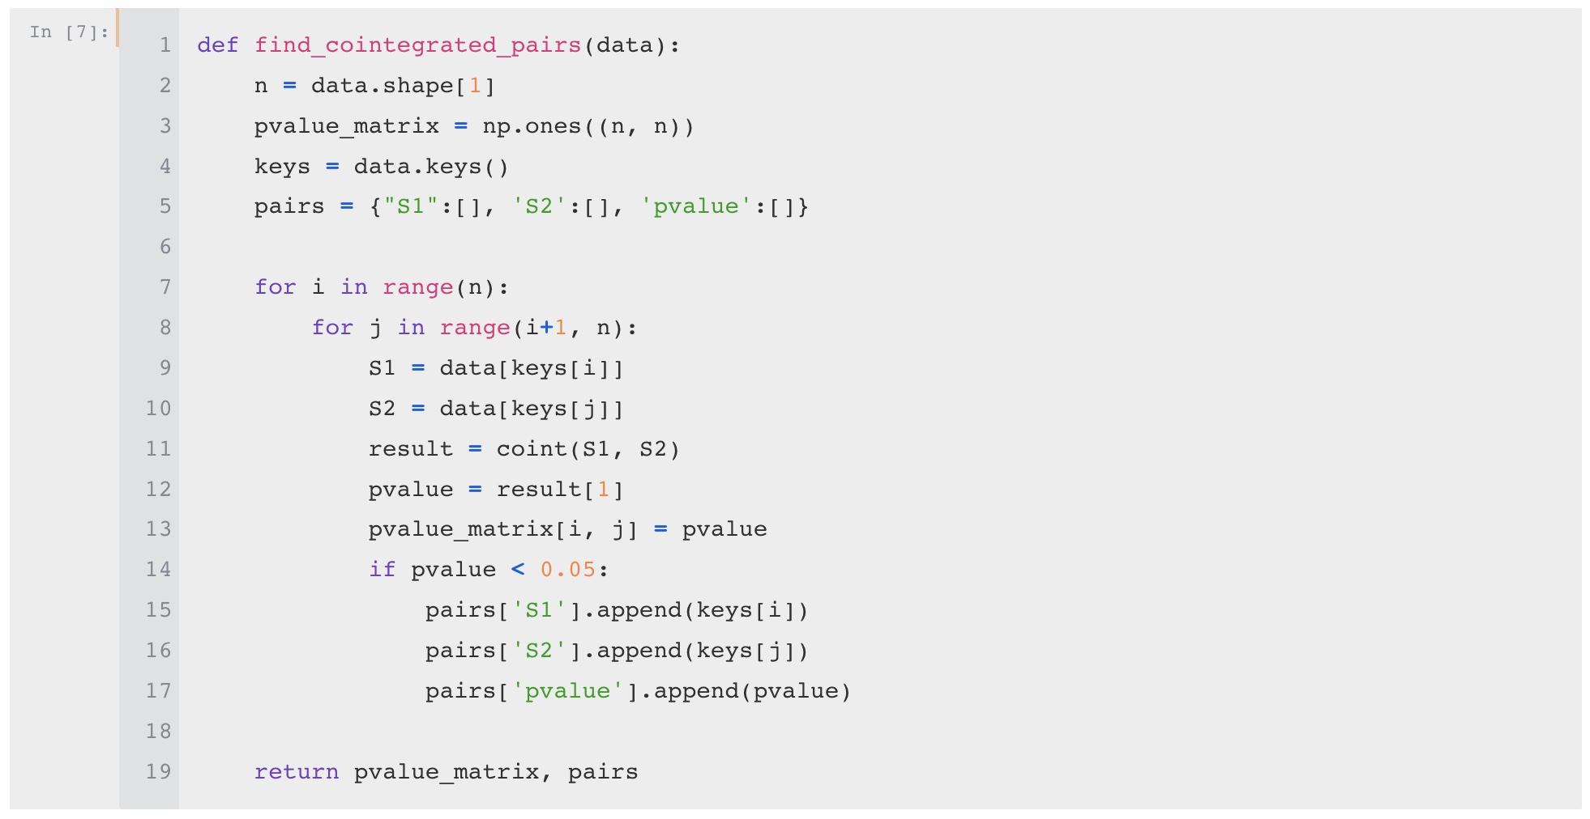
Find Pairs

Slide 25
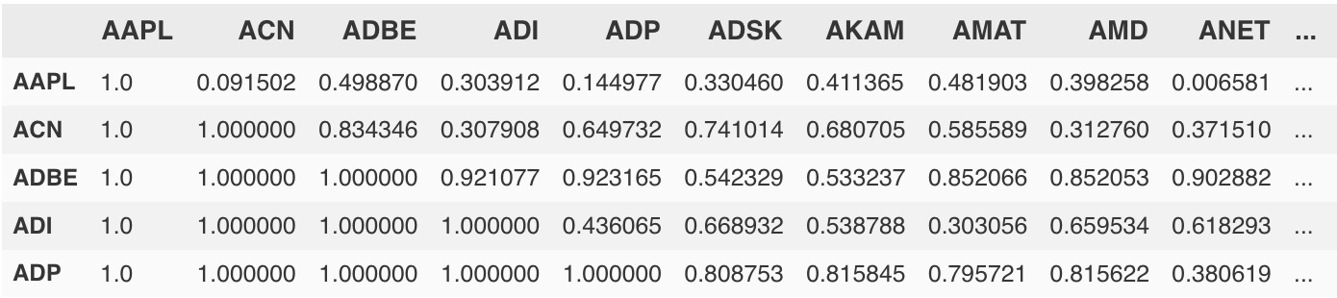
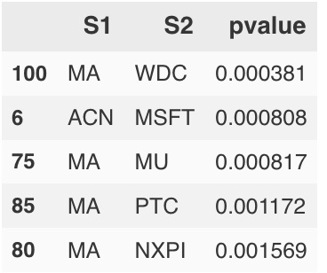
Find Pairs

Slide 26
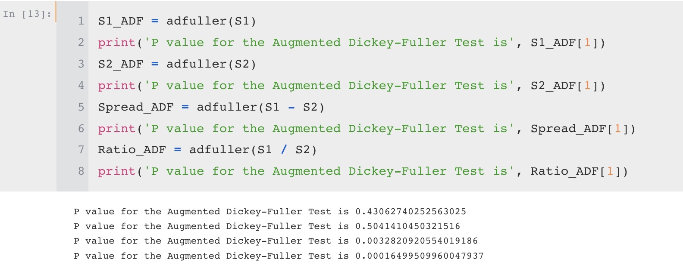
Find Pairs - Check for Stationarity

Slide 27
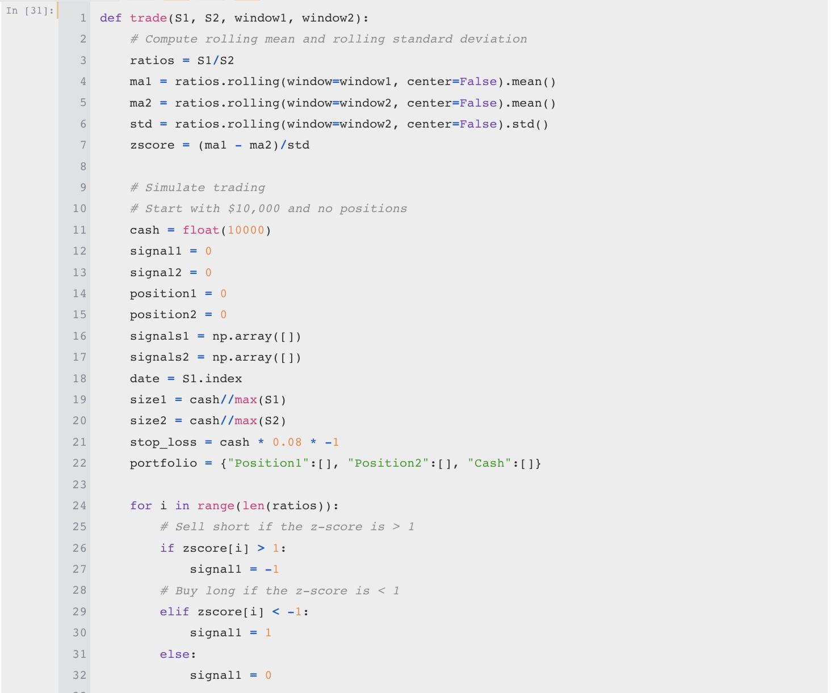
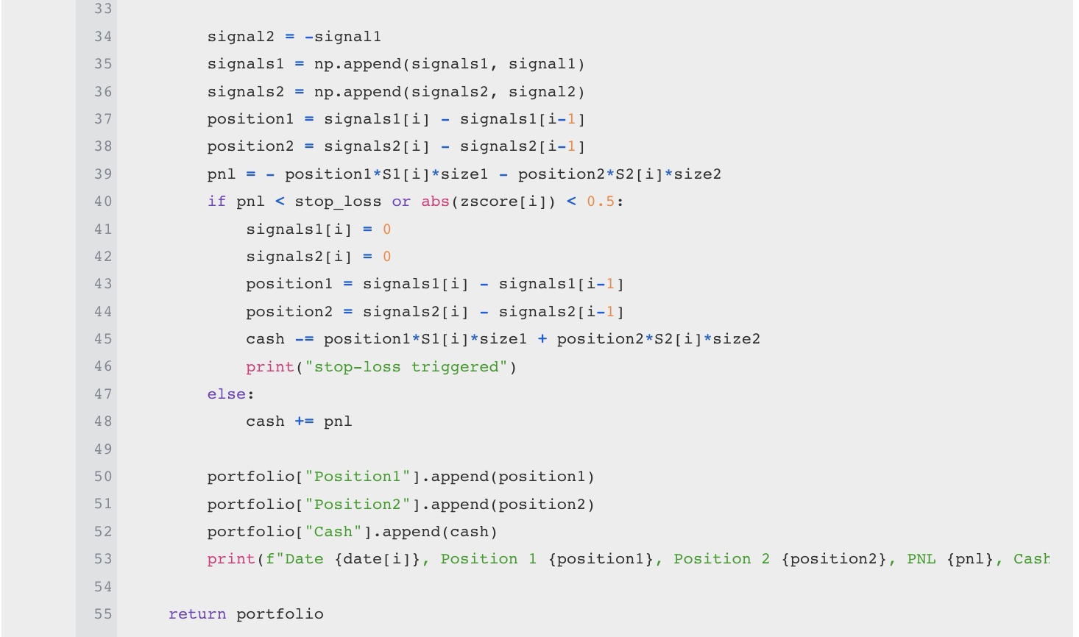
Trading

Slide 28
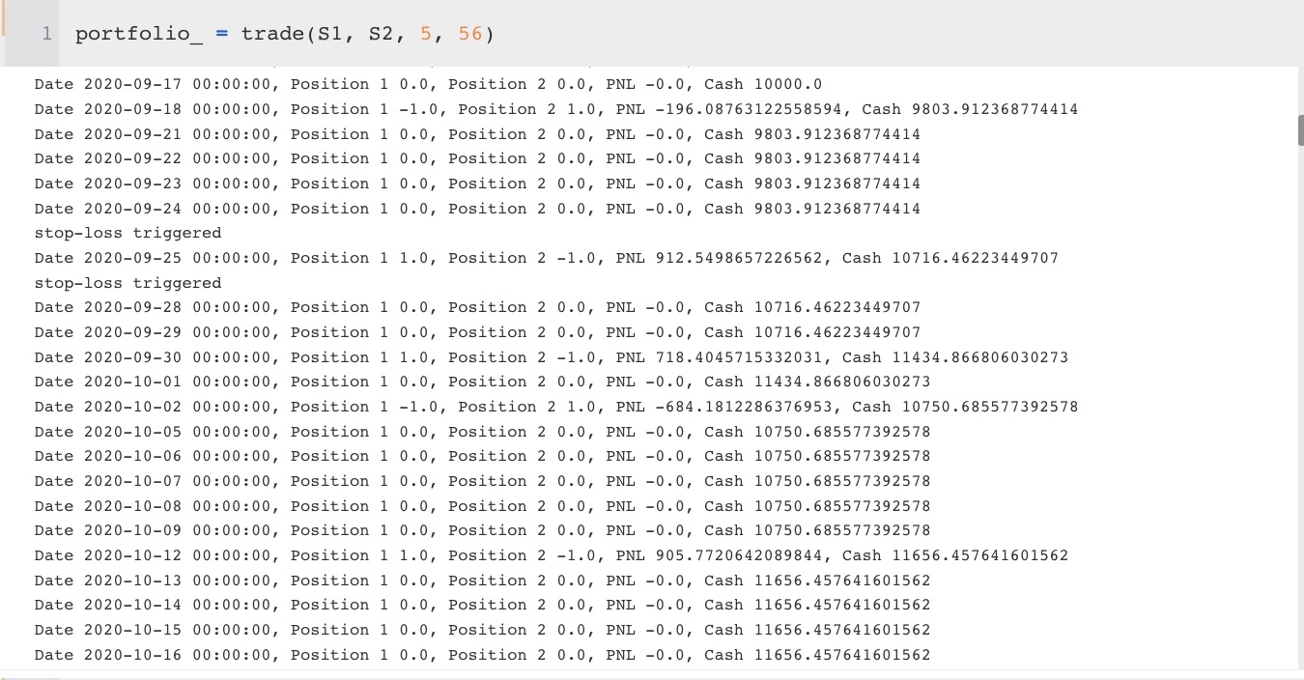
Backtesting

Slide 29
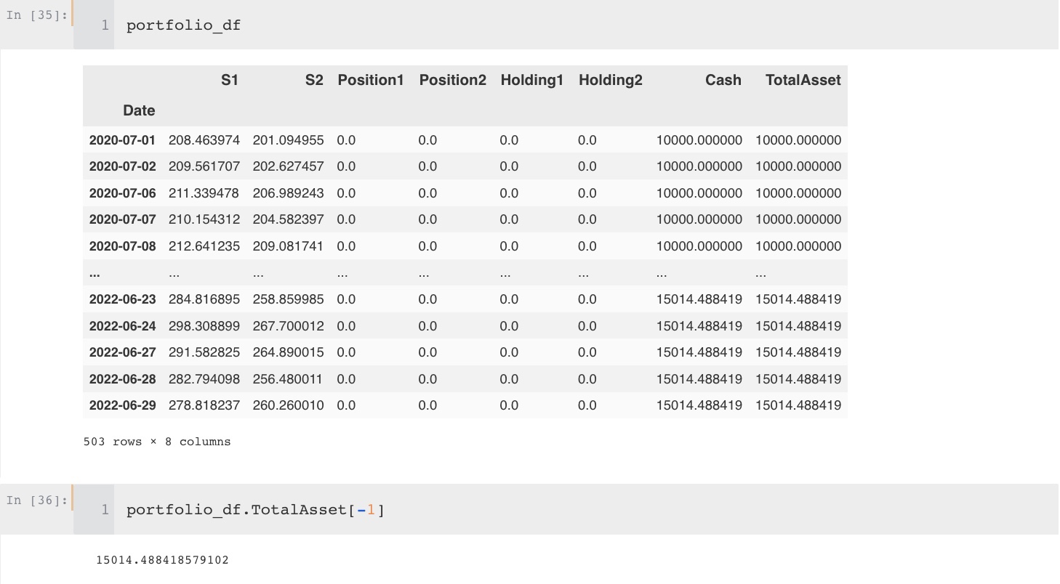
Backtesting

Slide 30
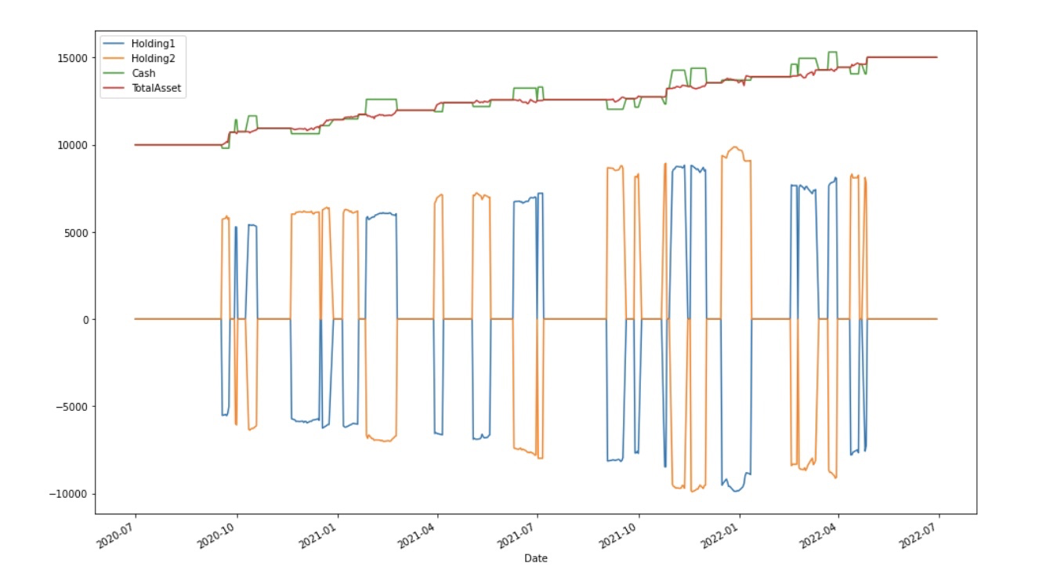
Backtesting

